Slide 1

Analysis using LSTM on Household Power Consumption Dataset
FICTA 2023
Abhishek Karmakar
Sharik Gazi
Shashwat Mishra
Shubhendra Kumar
Varsha Singh

Slide 2
Abstract
Time series forecasting emphasizes on a specific future value prediction or over a specific period of time. By utilizing the available time resources, forecasting assist in estimating significant values beyond time. Numerous real-world applications for forecasting exists which aims in estimating prominent values over time by exploiting the current time resources.
Consumption of electric power for household goods is one of the time series dataset consisting of residential power consumption by individual houses.

Slide 3
Introduction
A well founded energy power consumption model points out a demand in today’s world at an individual level of household electricity consumption as it creates favorable circumstances for power sector department to understand the future demands in the ways of its refinement in power supply.
With a technology which can help us to forecast demands in case of shortage or to understand behaviors of consumers would refer to the fundamentals expected future necessitate.

Slide 4
Data Description
The link to download the dataset is http://archive.ics.uci.edu/ml/datasets/Individual+household+electric+power+consumption#
The data file comprise of 2075259 samples. The sample consists of a record which is sampled at a rate of sixty seconds for duration of approx. 4 years, starting from Dec, 2006 – Nov, 2010. The values have been recorded from a house located in Sceaux, France (9.7km from center of Paris).
The Attribute Information is as follows:-
1. date: The pattern for date is day-month-year format as “dd-mm-yyyy”
2. time: The scheme for time is recorded as hour-month-second as “hh:mm:ss”
3. global active power: The data recorded consists of active power averaged on the basis of minute (in kilowatt)
4. global reactive power: The data recorded consists of reactive power averaged on the basis of minute (in kilowatt)
5. voltage: Voltage averaged on the basis of minute (in volt as S.I. unit)
6. global intensity: Intensity values consists of the average on the basis of minute (in ampere as S.I. unit)
7. sub metering 1: The data recorded consists of active energy consumed in kitchen (storage of active energy in watt-hour format)
8. sub metering 2: The data recorded consists of active energy consumed in laundry (storage of active energy in watt-hour format).
9. sub_metering_3: The data recorded consists of active energy consumed in household appliances (storage of active energy in watt-hour format).

Slide 5
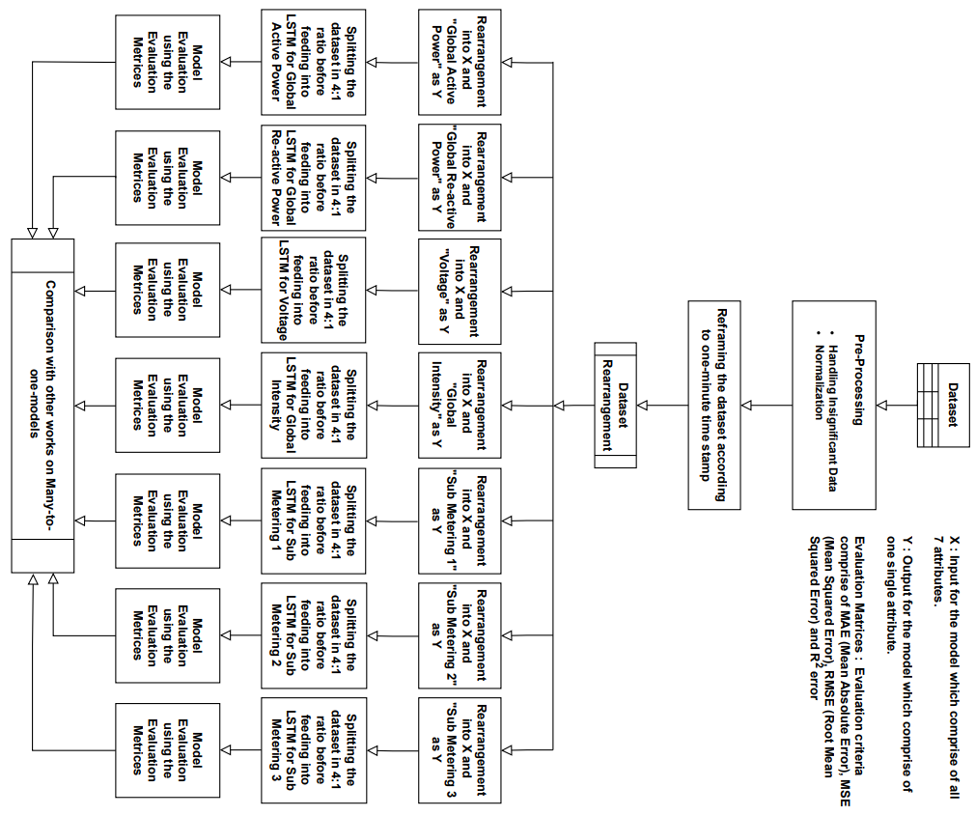
General Framework

Slide 6
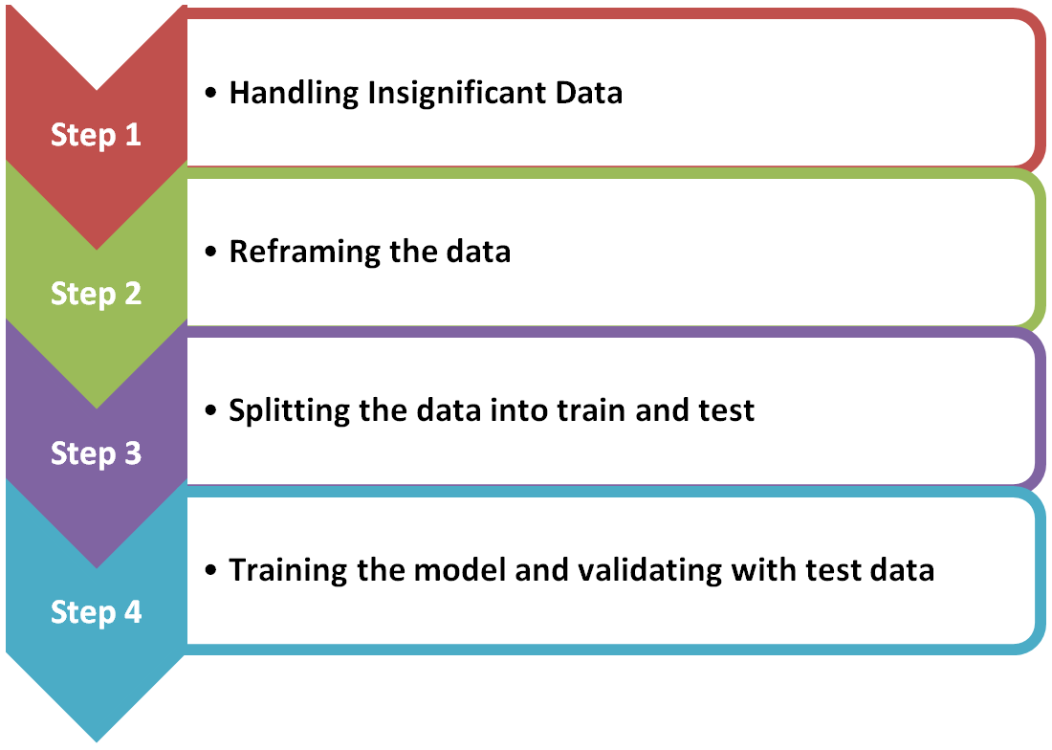
The Framework consists of basic 4 steps:-
A sole general purpose of implementing an LSTM model to fit and predict the power consumption of household dataset because it is best suited for large data, time series analysis, and solving sequential problems. The main purpose of this experiment is to achieve more accurate prediction result compared to the present work.
Consideration of the amount of input data is important to balance model accuracy and computation cost. We had divided the dataset into 80% and 20%.
We didn’t sample the data into hour, day, and week or quarter wise as our main focus is to show how LSTM works better than linear regression and neural network.

Slide 7
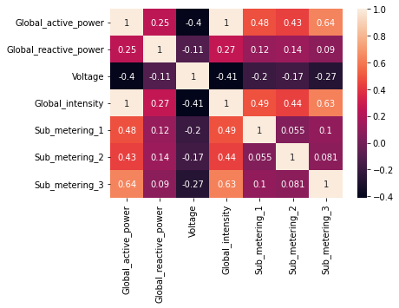
Handling Insignificant Data – Data Cleaning
Dataset consists unwanted string values represented as ‘?’. For the data cleaning part such insignificant values has been replaced by NULL. Furthermore, we had replaced all the values present in the dataset which lies outside of interquartile range with NULL as those as outliers. As we are now confirmed of the unimportant sample points, we replace all of them with the mean of that specific attribute. This process is followed by normalization so that it becomes an organized input data.

Slide 8
Reframing the dataset
In order to design the learning algorithm as a supervised machine learning problem for predicting any of all the attributes at the present time (t), all the seven attributes has been contemplated at prior time (t-1).

Slide 9
Splitting the dataset
The training to test data proportion used for LSTM Model is 4:1 collected from the reframed data. The training data consisted of 1660206 samples whereas the test data consists of 415052 samples.

Slide 10
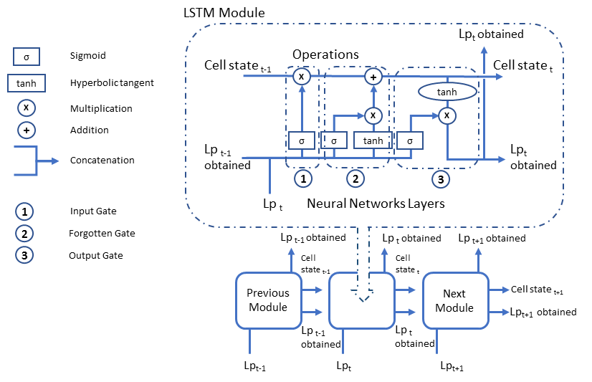
Training and validating the dataset
The training to test data proportion used for LSTM Model is 4:1 collected from the reframed data.

Slide 11
Global Active Power
Architecture
100 units in the first visible layer of LSTM
1000 units in first Dense layer
30 units in second Dense Layer
1 unit for output in Dense Layer
The loss function of mean squared error has been used with adam optimizer. We have trained the model on 25 epochs with a batch size of 70.

Slide 12
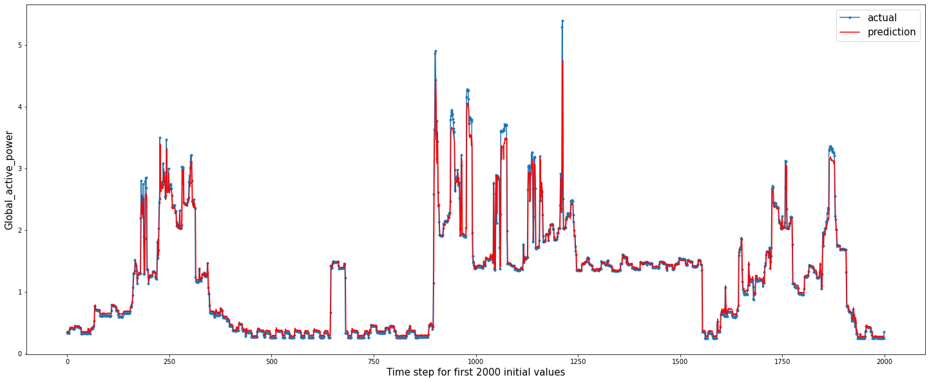
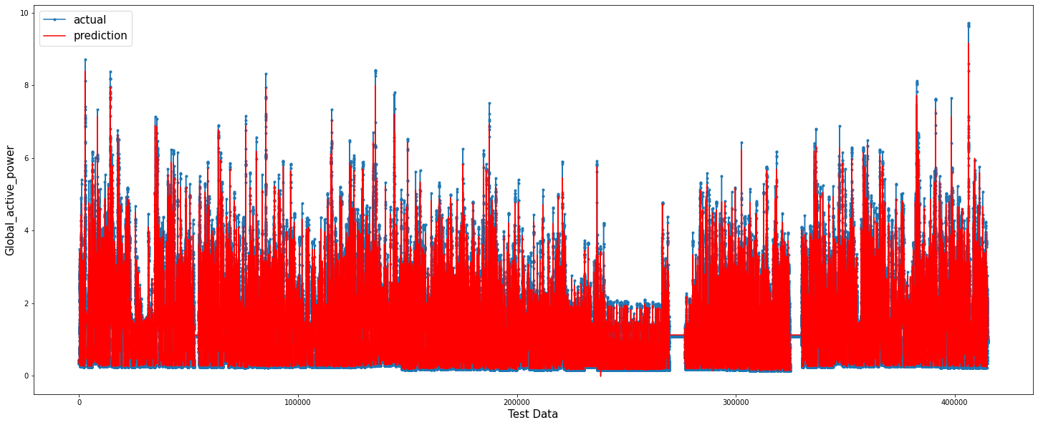
First 200 initial values of test data.
Prediction on the test data

Slide 13
Global Re-active Power
Architecture
100 units in the first visible layer of LSTM
1000 units in first Dense Layer
100 units in second Dense Layer
1 unit for output in Dense Layer
The loss function of mean squared error has been used with adam optimizer. In total 12 epochs has been with a batch size of 100 to train the model.

Slide 14
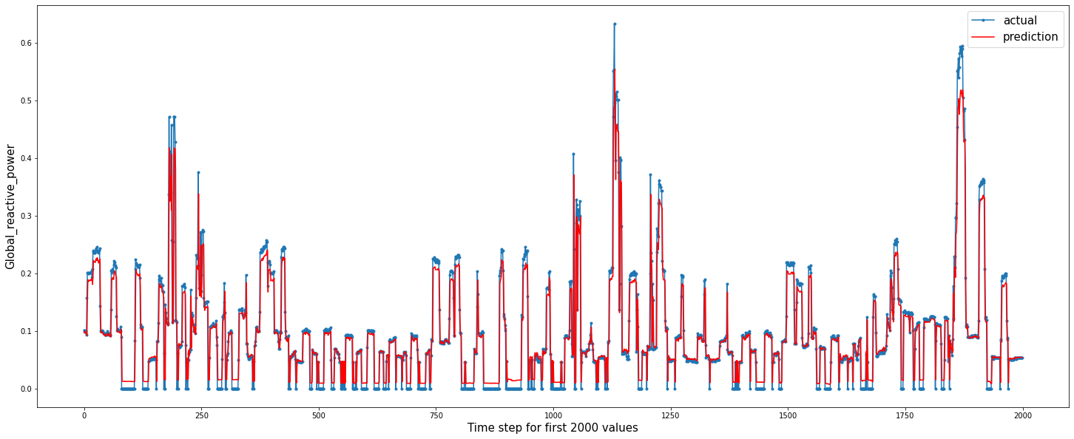
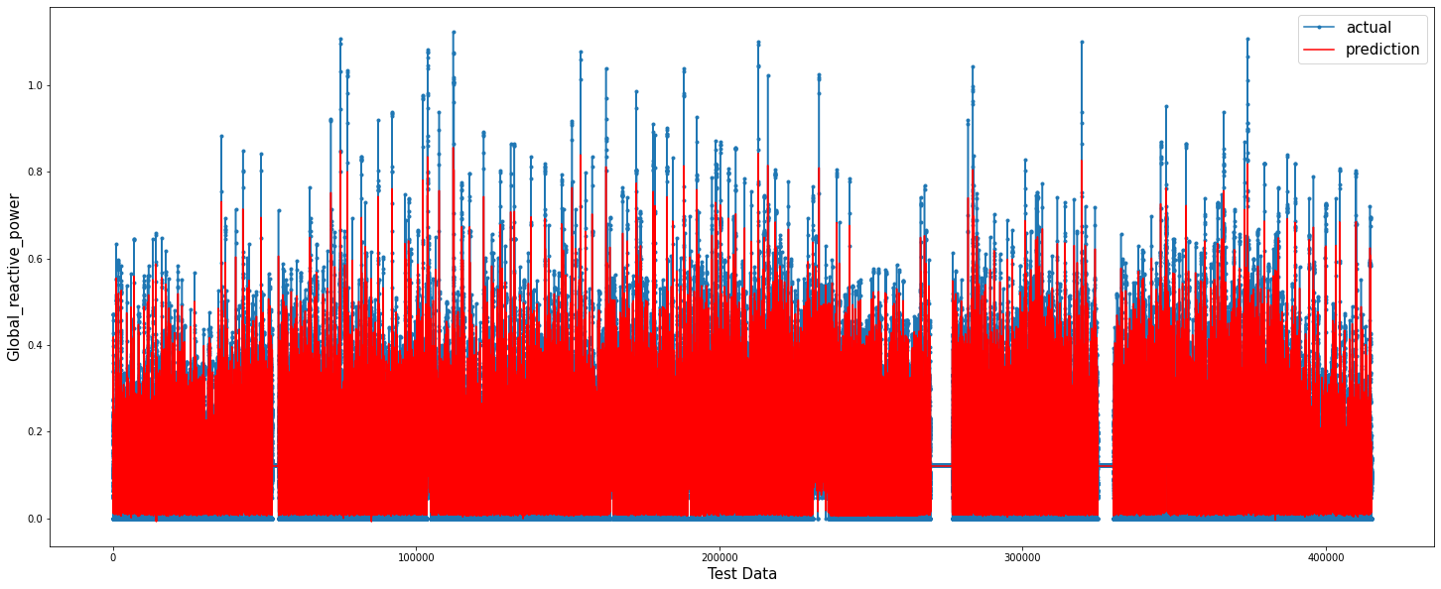
First 2000 initial values of the test data
Prediction on the test data

Slide 15
Architecture
100 units in the first visible layer of LSTM
2000 units in first Dense Layer
100 units in second Dense Layer
1 unit for output in Dense Layer
The loss function of mean squared error has been used with adam as optimizer. We have trained the model on 10 epochs with a batch size of 100.
Voltage

Slide 16
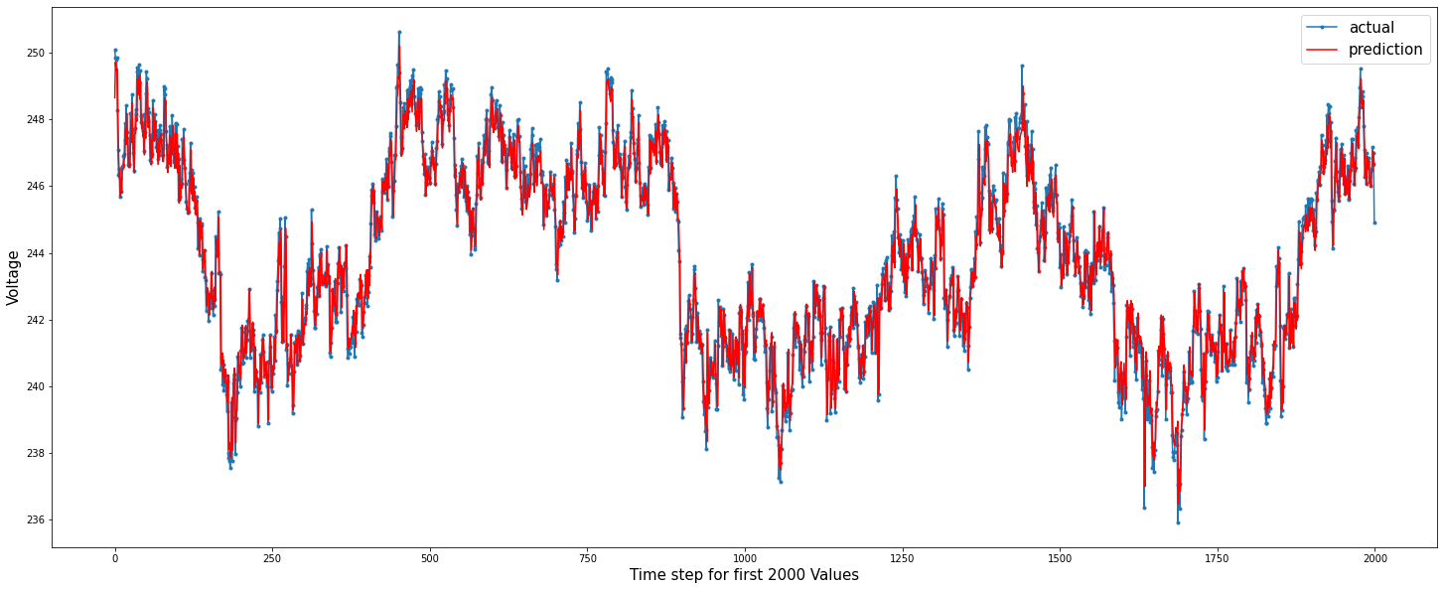
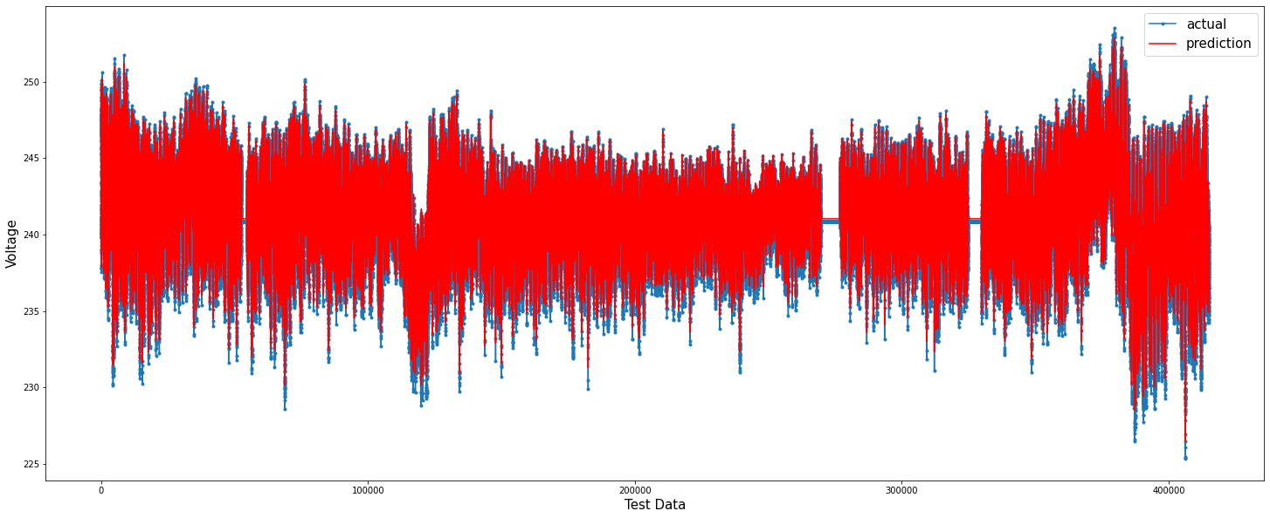
First 2000 initial values of the test data
Prediction on the test data

Slide 17
Architecture
100 units in the first visible layer of LSTM
1000 units in first Dense Layer
100 units in second Dense Layer
1 unit for output in Dense Layer
The loss function of mean squared error has been used with the adam optimizer. The training was done on 10 epochs with a batch size of 100.
Global Intensity

Slide 18
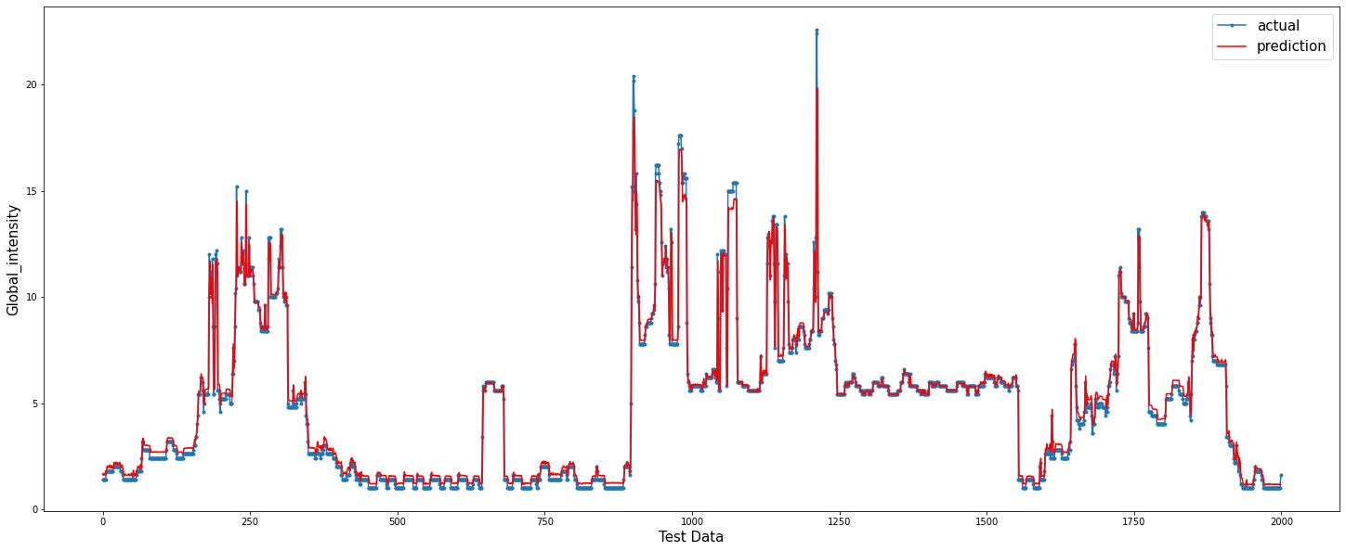
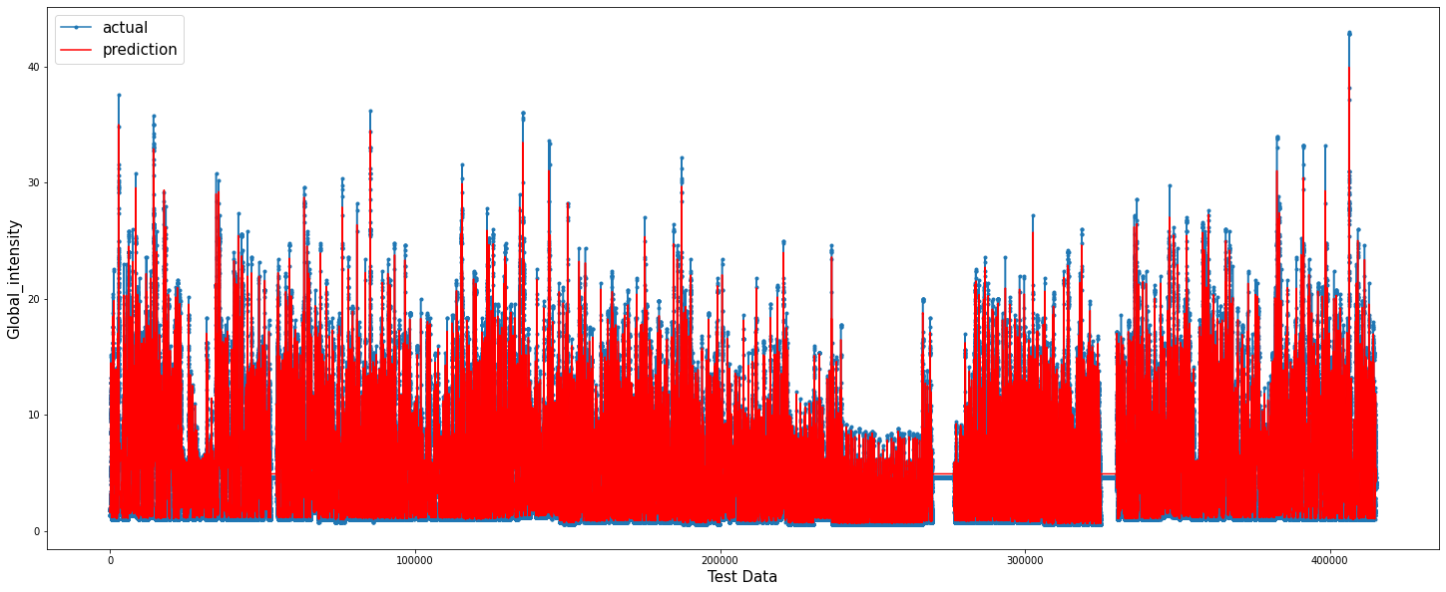
First 2000 initial values of the test data
Prediction on the test data

Slide 19
Architecture
200 units in the first visible layer of LSTM
1000 units in first Dense Layer
100 units in second Dense Layer
1 unit for output in Dense Layer
The loss function of mean squared error has been used with the adam optimizer. We have trained the model on 10 epochs with a batch size of 1
Sub Metering 1

Slide 20
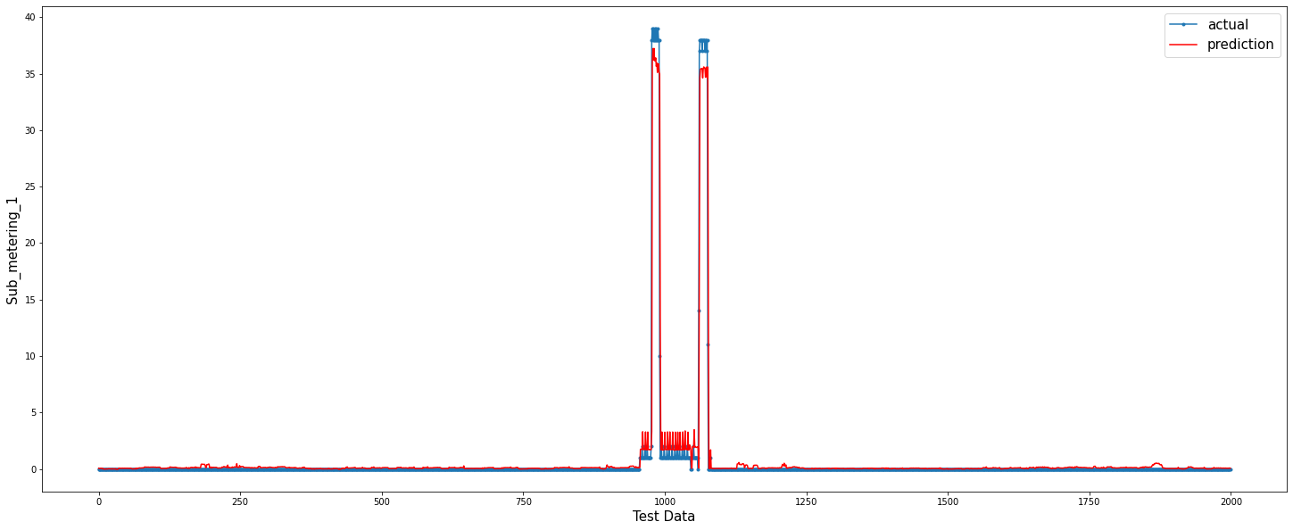
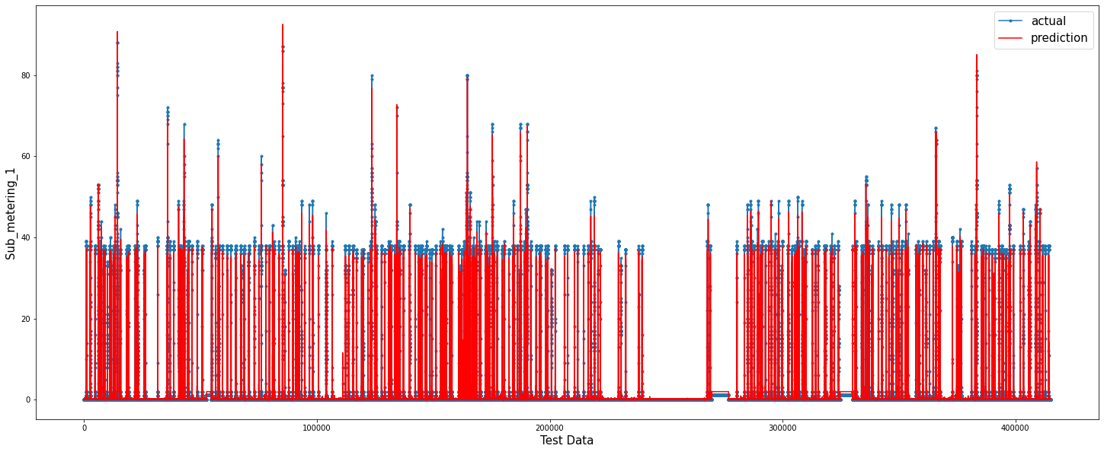
First 2000 initial values of the test data
Prediction on the Test Data

Slide 21
Architecture
100 units in the first visible layer of LSTM
1000 units in first Dense Layer
100 units in second Dense Layer
1 unit for output in Dense Layer
The loss function of mean squared error has been used with the adam optimizer on 15 epochs with a batch size of 100.
Sub Metering 2

Slide 22
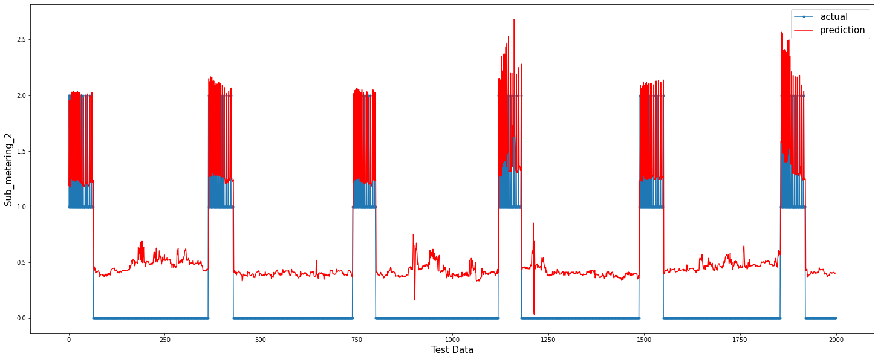
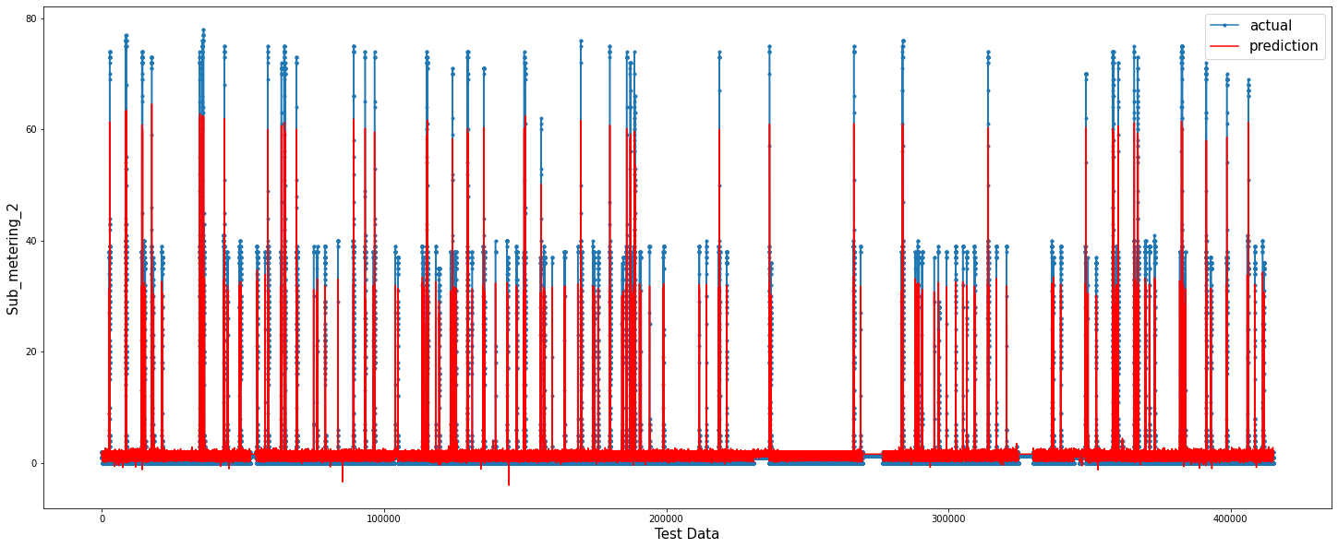
First 2000 initial values of the test data
Prediction on the test data

Slide 23
Architecture
100 units in the first visible layer of LSTM
5000 units in first Dense Layer
500 units in second Dense Layer
Dropout of 10%
1 unit for output in Dense Layer
The loss function of mean squared error has been used with the adam optimizer on 20 epochs with a batch size of 100
Sub Metering 3

Slide 24
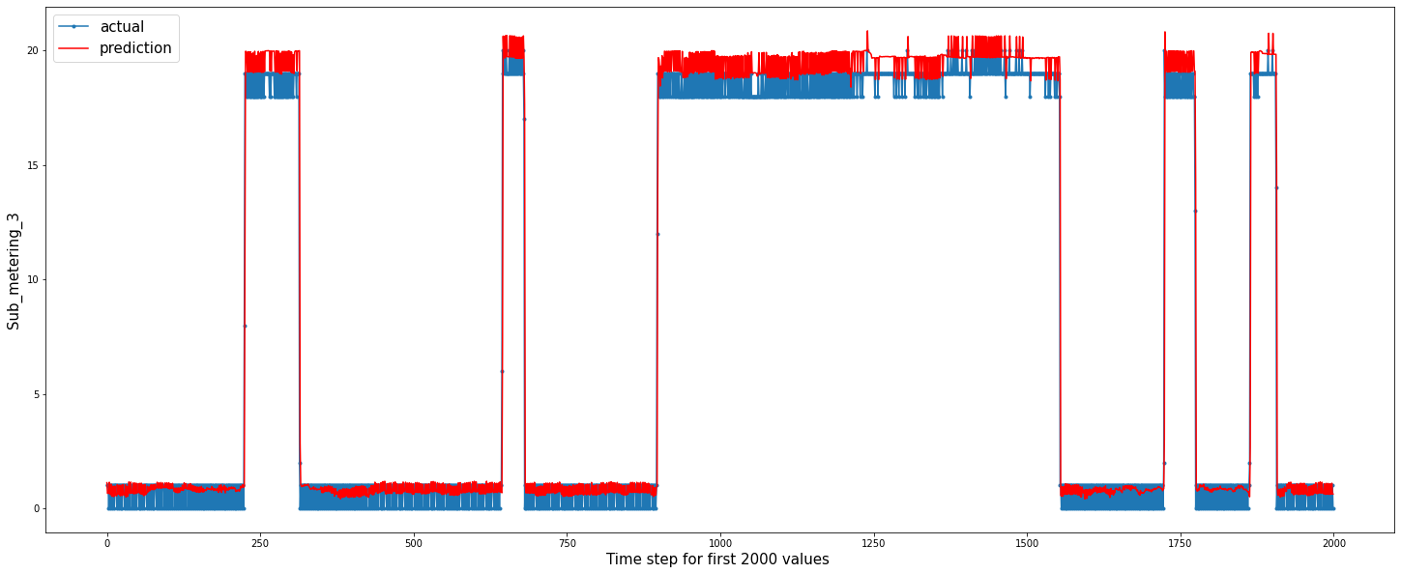
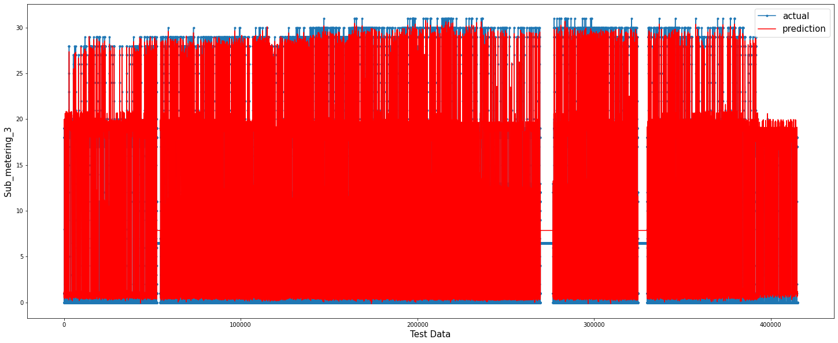
First 2000 initial values of the test data
Prediction on Test Data

Slide 25
Comparison using R2 score metric
Features | Linear Regression | MLP Regressor | LSTM (Our Work)
Global Active Power | 0.409 | 0.6679 | 0.940
Global Reactive Power | 0.008 | 0.034 | 0.844
Voltage | 0.073 | 0.085 | 0.937
Global Intensity | 0.394 | 0.6647 | 0.937
Sub_metering_1 | -- | -- | 0.872
Sub_metering_2 | -- | -- | 0.863
Sub_metering_3 | -- | -- | 0.956

Slide 26
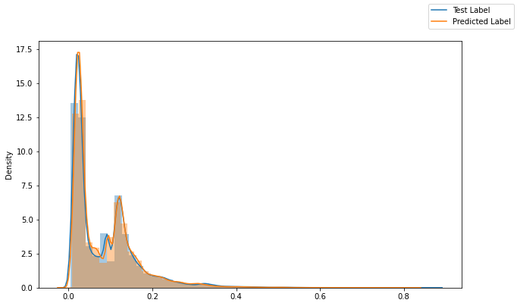
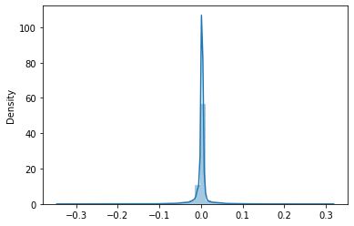
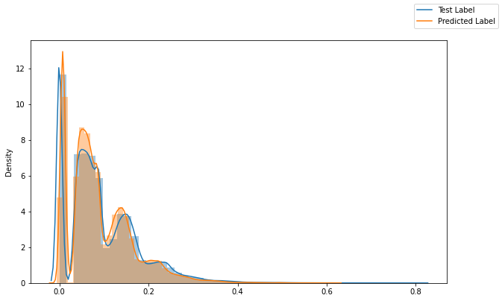
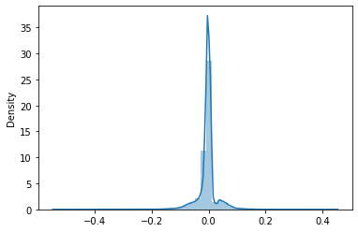
Model Evaluation on Various Parameters
Attributes | Displot of Test and Predicted | Difference of Variance | Difference between prediction and actual value | Error
Global Active Power |  | 0.00049 |  | MAE: 0.088 MSE: 0.045 RMSE: 0.213 R² ⁼ 0.940
Global Reactive Power |  | 0.00121 |  | MAE: 0.024 MSE: 0.002 RMSE: 0.045 R² ⁼ 0.844

Slide 27
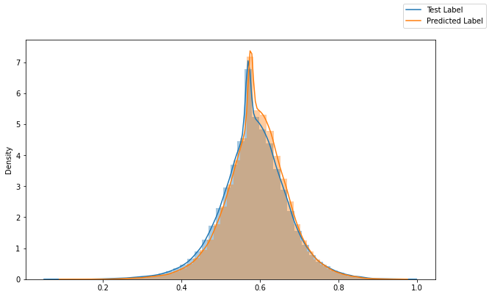
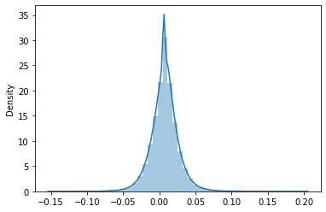
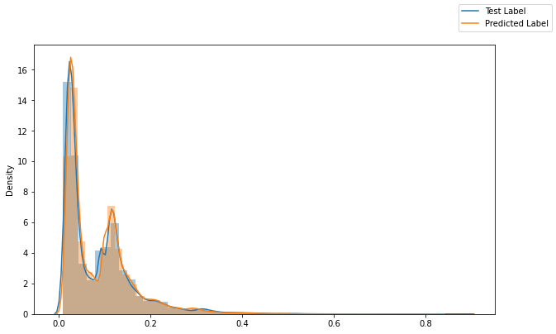
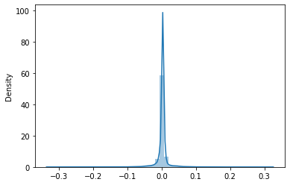
Model Evaluation on Various Parameters
Attributes | Displot of Test and Predicted | Difference of Variance | Difference between prediction and actual value | Error
Voltage |  | 0.00095 |  | MAE: 0.468 MSE: 0.385 RMSE: 0.621 R² ⁼ 0.945
Global Intensity |  | 0.00041 |  | MAE: 0.409 MSE: 0.835 RMSE: 0.914 R² ⁼ 0.937

Slide 28
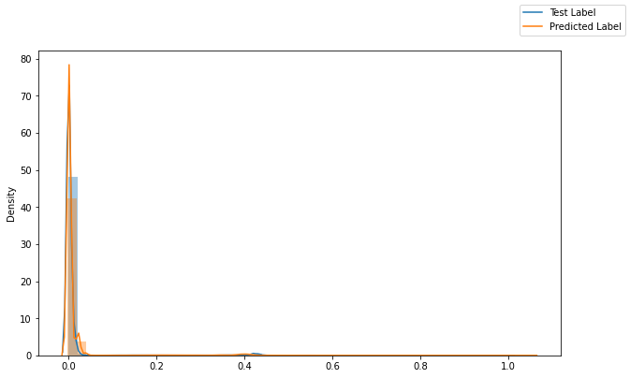
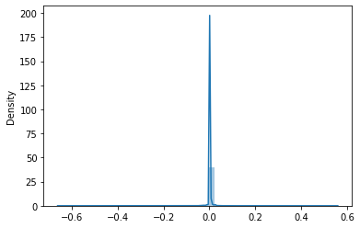
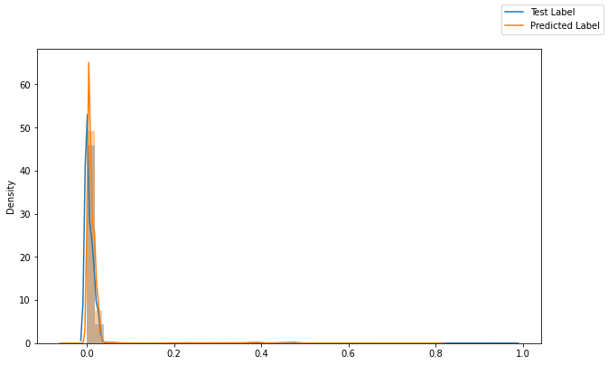
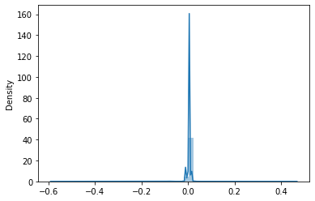
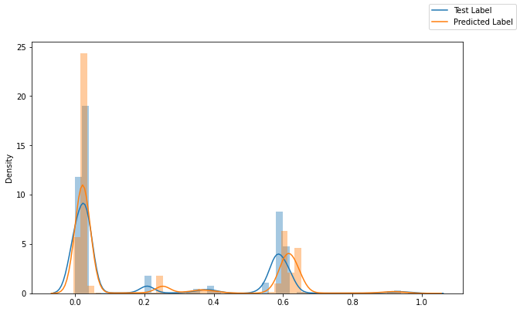
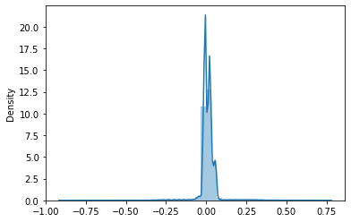
Model Evaluation on Various Parameters
Attributes | Displot of Test and Predicted | Difference of Variance | Difference between prediction and actual value | Error
Sub_metering_1 |  | 0.00028 |  | MAE: 0.355 MSE: 3.753 RMSE: 1.937 R² ⁼ 0.872
Sub_metering_2 |  | 0.00011 |  | MAE: 0.686 MSE: 3.169 RMSE: 1.780 R² ⁼ 0.863
Sub_metering_3 |  | 0.00501 |  | MAE: 0.870 MSE: 3.006 RMSE: 1.751 R² ⁼ 0.956

Slide 29

Conclusion
It shows the performance of LSTM to be better than Linear Regression and Neural Network when trained for single attribute output. This network has been modeled for many-to-one output.
The model comparison has been compared with a Bi-directional LSTM as well, but even in that case the LSTM network has performed better.

Slide 30
Thank You !!

